Slide 1
Chapter 12 Exception Handling and Text IO

Slide 2
Motivations
When a program runs into a runtime error, the program terminates abnormally.
How can you handle the runtime error so that the program can continue to run or terminate gracefully?
This is the subject we will introduce in this chapter.

Slide 3
Objectives
To get an overview of exceptions and exception handling.
To explore the advantages of using exception handling.
To distinguish exception types: Error (fatal) vs. Exception (nonfatal) and checked vs. unchecked.
To declare exceptions in a method header.
To throw exceptions in a method.
To write a try-catch block to handle exceptions.
To explain how an exception is propagated.
To obtain information from an exception object.
To develop applications with exception handling.
To use the finally clause in a try-catch block.
To use exceptions only for unexpected errors.
To rethrow exceptions in a catch block.
To define custom exception classes.

Slide 4
Programming Errors
Syntax Errors – Detected by the compiler
Runtime Errors – Causes the program to abort
Logic Errors – Produces incorrect result

Slide 5
Exception-Handling Overview
Exception handling enables a program to deal with exceptional situations and continue its normal execution.
An exception is an object that represents an error or a condition that prevents execution from proceeding normally.
Exceptions are thrown from a method. The caller of the method can catch and handle the exception.
Notes:
Examples: ArrayIndexOutOfBoundsException, InputMismatchException , ClassCastException

Slide 6
Exception-Handling Overview
Show runtime error
Quotient
Run
Fix it using an if statement
QuotientWithIf
Run
With a method
QuotientWithMethod
Run

Slide 7
Exception-Handling Example
QuotientWithException
Run

Slide 8
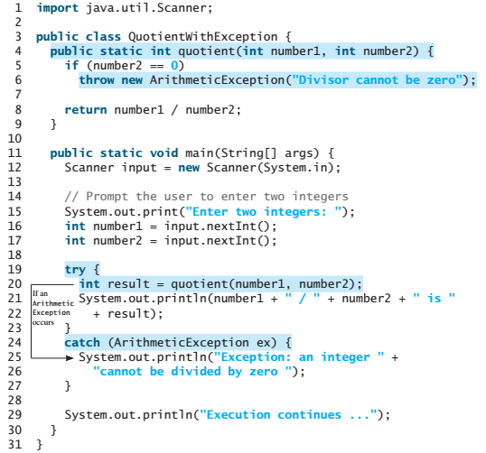
Exception-Handling
The value thrown is called an exception.
The execution of a throw statement is called throwing an exception.
When an exception is thrown, the normal execution flow is interrupted.

Slide 9
Exception-Handling
The try block contains the code that is executed in normal circumstances.
The exception is caught by the catch block.
The code in the catch block is executed to handle the exception. Afterward, the statement after the catch block is executed.

Slide 10
A template for a try-throw-catch block
try { Code to run; A statement or a method that may throw an exception; More code to run; } catch (type ex) { Code to process the exception; }

Slide 11
Exception Advantages
Now you see the advantages of using exception handling.
It enables a method to throw an exception to its caller.
Without this capability, a method must handle the exception or terminate the program.
An exception may be thrown directly by using a throw statement in a try block, or by invoking a method that may throw an exception.
The key benefit of exception handling is separating the detection of an error (done in a called method) from the handling of an error (done in the calling method).

Slide 12
Handling InputMismatchException
InputMismatchExceptionDemo
Run
By handling InputMismatchException, your program will continuously read an input until it is correct.

Slide 13
☑ Check Point
What is the advantage of using exception handling?
Which of the following statements will throw an exception? System.out.println(1 / 0); System.out.println(1.0 / 0);
<--- ANSWER --->
The advantages of using exception handling: It enables a method to throw an exception to its caller. The caller can handle this exception. Without this capability, the called method itself must handle the exception or terminate the program. Often the called method does not know how to handle the exception. So, it needs to pass the exception to its caller for handling.
System.out.println(1 / 0); // Throws an exception System.out.println(1.0 / 0); // Will not throw an exception.

Slide 14
☑ Check Point
Point out the problem in the following code. Does the code throw any exceptions? long value = Long.MAX_VALUE + 1; System.out.println(value);
What does the JVM do when an exception occurs? How do you catch an exception?
<--- ANSWER --->
Adding 1 to Long.MAX_VALUE exceeds the maximum value allowed by a long value. But the current versions of Java does not report this as an exception.
When an excepion occurs, Java searches for a handler in the catch clause. So, to catch an exception in your program, you need to write a try-catch statement like this: try { } catch (Exception ex) { // Catch and process exception }

Slide 15
☑ Check Point
What is the output of the following code? public class Test { public static void main(String[] args) { try { int value = 30; if (value < 40) throw new Exception("value is too small"); } catch (Exception ex) { System.out.println(ex.getMessage()); } System.out.println("Continue after the catch block"); } }
What would be the output if the line int value = 30; were changed to int value = 50;
<--- ANSWER --->
value is too small Continue after the catch block
Continue after the catch block

Slide 16
☑ Check Point
Show the output of the following code.
(a) public class Test { public static void main(String[] args) { for (int i = 0; i < 2; i++) { System.out.print(i + " "); try { System.out.println(1 / 0); } catch (Exception ex) { } } } }
(b) public class Test { public static void main(String[] args) { try { for (int i = 0; i < 2; i++) { System.out.print(i + " "); System.out.println(1 / 0); } } catch (Exception ex) { } } }
<--- ANSWER --->
a. 0 1
b. 0

Slide 17
Exception Types
Exceptions are objects, and objects are defined using classes.
The root class for exceptions is java.lang.Throwable.

Slide 18
System Errors
System errors are thrown by JVM and represented in the Error class. The Error class describes internal system errors. Such errors rarely occur. If one does, there is little you can do beyond notifying the user and trying to terminate the program gracefully.

Slide 19
Exceptions
Exception describes errors caused by your program and external circumstances. These errors can be caught and handled by your program.

Slide 20
Runtime Exceptions
RuntimeException is caused by programming errors, such as bad casting, accessing an out-of-bounds array, and numeric errors.

Slide 21
Checked Exceptions vs. Unchecked Exceptions
RuntimeException, Error and their subclasses are known as unchecked exceptions.
All other exceptions are known as checked exceptions, meaning that the compiler forces the programmer to check and deal with the exceptions.

Slide 22
Unchecked Exceptions
In most cases, unchecked exceptions reflect programming logic errors that are not recoverable.
For example, a NullPointerException is thrown if you access an object through a reference variable before an object is assigned to it;
an IndexOutOfBoundsException is thrown if you access an element in an array outside the bounds of the array.
These are the logic errors that should be corrected in the program. Unchecked exceptions can occur anywhere in the program. To avoid cumbersome overuse of try-catch blocks, Java does not mandate you to write code to catch unchecked exceptions.

Slide 23
Unchecked Exceptions
Unchecked exception.

Slide 24
☑ Check Point
Describe the Java Throwable class, its subclasses, and the types of exceptions.
<--- ANSWER --->
See the section "Exceptions and Exception Types. The Throwable class is the root of Java exception classes. Error and Exception are subclasses of Throwable. Error describes fatal system errors, and Exception describes the errors that can be handled by Java programs. The subclasses of Error are LinkageError, VirtualMachineError, and AWTError. The subclasses of Exception include RuntimeException, IOException, AWTException, and InstantiationException.

Slide 25
☑ Check Point
What RuntimeException will the following programs throw, if any?
(a) public class Test { public static void main(String[] args) { System.out.println(1 / 0); } }
(b) public class Test { public static void main(String[] args) { int[] list = new int[5]; System.out.println(list[5]); } }
(c) public class Test { public static void main(String[] args) { String s = "abc"; System.out.println(s.charAt(3)); } }
<--- ANSWER --->
a. ArithmeticException
b. ArrayIndexOutOfBoundsException
c. StringIndexOutOfBoundsException

Slide 26
☑ Check Point
What RuntimeException will the following programs throw, if any?
(d) public class Test { public static void main(String[] args) { Object o = new Object(); String d = (String)o; } }
(e) public class Test { public static void main(String[] args) { Object o = null; System.out.println(o.toString()); } }
(f) public class Test { public static void main(String[] args) { System.out.println(1.0 / 0); } }
<--- ANSWER --->
d. ClassCastException
e. NullPointerException
f. No exception

Slide 27
Declaring, Throwing, and Catching Exceptions

Slide 28
Declaring Exceptions
Every method must state the types of checked exceptions it might throw. This is known as declaring exceptions.
public void myMethod() throws IOException
public void myMethod()
throws IOException, OtherException
If a method does not declare exceptions in the superclass, you cannot override it to declare exceptions in the subclass.

Slide 29
Throwing Exceptions
When the program detects an error, the program can create an instance of an appropriate exception type and throw it. This is known as throwing an exception. Here is an example,
throw new TheException();
TheException ex = new TheException();
throw ex;
< Or >
throw new IllegalArgumentException("Wrong Argument");

Slide 30
Throwing Exceptions Example
/** Set a new radius */
public void setRadius(double newRadius)
throws IllegalArgumentException {
if (newRadius >= 0)
radius = newRadius;
else
throw new IllegalArgumentException(
"Radius cannot be negative");
}

Slide 31
Notes & Tips
IllegalArgumentException is an exception class in the Java API. In general, each exception class in the Java API has at least two constructors:
a no-arg constructor, and
a constructor with a String argument that describes the exception. This argument is called the exception message, which can be obtained using getMessage().
The keyword to declare an exception is throws, and the keyword to throw an exception is throw.

Slide 32
Catching Exceptions
try {
statements; // Statements that may throw exceptions
}
catch (Exception1 exVar1) {
handler for exception1;
}
catch (Exception2 exVar2) {
handler for exception2;
}
...
catch (ExceptionN exVar3) {
handler for exceptionN;
}

Slide 33
Catching Exceptions

Slide 34
Catch or Declare Checked Exceptions
Suppose p2 is defined as follows:

Slide 35
Catch or Declare Checked Exceptions
Java forces you to deal with checked exceptions. If a method declares a checked exception (i.e., an exception other than Error or RuntimeException), you must invoke it in a try-catch block or declare to throw the exception in the calling method. For example, suppose that method p1 invokes method p2 and p2 may throw a checked exception (e.g., IOException), you have to write the code as shown in (a) or (b).

Slide 36
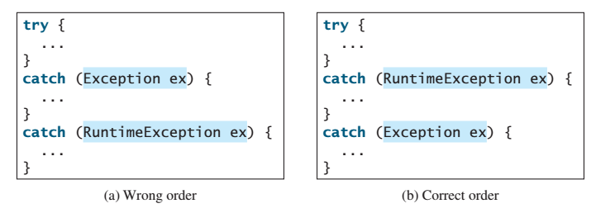
Order of Exception Handlers
The order in which exceptions are specified in catch blocks is important.
A compile error will result if a catch block for a superclass type appears before a catch block for a subclass type.
For example, the ordering in (a) is erroneous, because RuntimeException is a subclass of Exception.
The correct ordering should be as shown in (b).

Slide 37
Example: Declaring, Throwing, and Catching Exceptions
Objective:
This example demonstrates declaring, throwing, and catching exceptions by modifying the setRadius method in the Circle class defined in Chapter 8.
The new setRadius method throws an exception if radius is negative.
TestCircleWithException
CircleWithException
Run

Slide 38
☑ Check Point
What is the purpose of declaring exceptions?
How do you declare an exception, and where?
Can you declare multiple exceptions in a method header?
What is a checked exception, and what is an unchecked exception?
<--- ANSWER --->
The purpose of declaring exceptions is to tell the Java runtime system what can go wrong.
You declare an exception using the throws keyword in the method declaration.
You can declare multiple exceptions separated by commas.
A checked exception must be explicitly declared in the method declaration, if a method throws it. A checked exception must be caught in a try-catch block. An unchecked exception does not need to be declared and does not need to be caught. In Java, the only unchecked exceptions are RuntimeException and Error and their subclasses.

Slide 39
☑ Check Point
How do you throw an exception? Can you throw multiple exceptions in one throw statement?
What is the keyword throw used for? What is the keyword throws used for?
<--- ANSWER --->
You use the throw statement in the method to throw an exception. You cannot throw multiple exceptions in a single throw statement.
throw is for throwing exceptions and throws is for claiming exceptions.

Slide 40
☑ Check Point
Suppose that statement2 causes an exception in the following try-catch block: try { statement1; statement2; statement3; } catch (Exception1 ex1) { } catch (Exception2 ex2) { } statement4;
Answer the following questions:
1. Will statement3 be executed?
2. If the exception is not caught, will statement4 be executed?
3. If the exception is caught in the catch block, will statement4 be executed?
<--- ANSWER --->
1. No.
2. No.
3. Yes.

Slide 41
☑ Check Point
What is displayed when running the following program? public class Test { public static void main(String[] args) { try { int[] list = new int[10]; System.out.println("list[10] is " + list[10]); } catch (ArithmeticException ex) { System.out.println("ArithmeticException"); } catch (RuntimeException ex) { System.out.println("RuntimeException"); } catch (Exception ex) { System.out.println("Exception"); } } }
<--- ANSWER --->
RuntimeException Reason: list[10] throws ArrayIndexOutOfBoundsException that is a subclass of RuntimeException.

Slide 42
☑ Check Point
What is displayed when running the following program? public class Test { public static void main(String[] args) { try { method(); System.out.println("After the method call"); } catch (ArithmeticException ex) { System.out.println("ArithmeticException"); } catch (RuntimeException ex) { System.out.println("RuntimeException"); } catch (Exception e) { System.out.println("Exception"); } } static void method() throws Exception { System.out.println(1 / 0); } }
<--- ANSWER --->
ArithmeticException Reason: method() throws ArithmeticException.

Slide 43
☑ Check Point
What is displayed when running the following program? public class Test { public static void main(String[] args) { try { method(); System.out.println("After the method call"); } catch (RuntimeException ex) { System.out.println("RuntimeException in main"); } catch (Exception ex) { System.out.println("Exception in main"); } } static void method() throws Exception { try { String s ="abc"; System.out.println(s.charAt(3)); } catch (RuntimeException ex) { System.out.println("RuntimeException in method()"); } catch (Exception ex) { System.out.println("Exception in method()"); } } }
<--- ANSWER --->
RuntimeException in method() After the method call Reason: s.charAt(3) throws StringIndexOutOfBoundsException that is a subclass of RuntimeException. This exception is caught in method(). The main method continues its normal execution flow.

Slide 44
☑ Check Point
What does the method getMessage() do?
What does the method printStackTrace() do?
Does the presence of a try-catch block impose overhead when no exception occurs?
Correct a compile error in the following code: public void m(int value) { if (value < 40) throw new Exception("value is too small"); }
<--- ANSWER --->
The getMessage() is defined in the Throwable class to return a string that describes the exception.
To display trace information to the console.
No
The method throws a checked exception. It must be caught or thrown. You may fix it as follows: public void m(int value) throws Exception { if (value < 40) throw new Exception("value is too small"); }

Slide 45
The finally Clause
The finally clause is always executed regardless whether an exception occurred or not.
try {
statements;
}
catch(TheException ex) {
handling ex;
}
finally {
finalStatements;
}

Slide 46
Trace a Program Execution
animation
Suppose no exceptions in the statements
try {
statements;
}
catch(TheException ex) {
handling ex;
}
finally {
finalStatements;
}
Next statement;

Slide 47
Trace a Program Execution
animation
The final block is always executed
try {
statements;
}
catch(TheException ex) {
handling ex;
}
finally {
finalStatements;
}
Next statement;

Slide 48
Trace a Program Execution
animation
Next statement in the method is executed
try {
statements;
}
catch(TheException ex) {
handling ex;
}
finally {
finalStatements;
}
Next statement;

Slide 49
Trace a Program Execution
animation
try {
statement1;
statement2;
statement3;
}
catch(Exception1 ex) {
handling ex;
}
finally {
finalStatements;
}
Next statement;
Suppose an exception of type Exception1 is thrown in statement2

Slide 50
Trace a Program Execution
animation
try {
statement1;
statement2;
statement3;
}
catch(Exception1 ex) {
handling ex;
}
finally {
finalStatements;
}
Next statement;
The exception is handled.

Slide 51
Trace a Program Execution
animation
try {
statement1;
statement2;
statement3;
}
catch(Exception1 ex) {
handling ex;
}
finally {
finalStatements;
}
Next statement;
The final block is always executed.

Slide 52
Trace a Program Execution
animation
try {
statement1;
statement2;
statement3;
}
catch(Exception1 ex) {
handling ex;
}
finally {
finalStatements;
}
Next statement;
The next statement in the method is now executed.

Slide 53
Trace a Program Execution
animation
try {
statement1;
statement2;
statement3;
}
catch(Exception1 ex) {
handling ex;
}
catch(Exception2 ex) {
handling ex;
throw ex;
}
finally {
finalStatements;
}
Next statement;
statement2 throws an exception of type Exception2.

Slide 54
Trace a Program Execution
animation
try {
statement1;
statement2;
statement3;
}
catch(Exception1 ex) {
handling ex;
}
catch(Exception2 ex) {
handling ex;
throw ex;
}
finally {
finalStatements;
}
Next statement;
Handling exception

Slide 55
Trace a Program Execution
animation
try {
statement1;
statement2;
statement3;
}
catch(Exception1 ex) {
handling ex;
}
catch(Exception2 ex) {
handling ex;
throw ex;
}
finally {
finalStatements;
}
Next statement;
Execute the final block

Slide 56
Trace a Program Execution
animation
try {
statement1;
statement2;
statement3;
}
catch(Exception1 ex) {
handling ex;
}
catch(Exception2 ex) {
handling ex;
throw ex;
}
finally {
finalStatements;
}
Next statement;
Rethrow the exception and control is transferred to the caller

Slide 57
☑ Check Point
Suppose you run the following code: public static void main(String[] args) throws Exception2 { m(); statement7; } public static void m() { try { statement1; statement2; statement3; } catch (Exception1 ex1) { statement4; } finally { statement5; } statement6; }
Answer the questions:
1. If no exception occurs, which statements are executed?
2. If statement2 throws an exception of type Exception1, which statements are executed?
3. If statement2 throws an exception of type Exception2, which statements are executed?
4. If statement2 throws an exception that is neither Exception1 nor Exception2, which statements are executed?
<--- ANSWER --->
1. statement1, statement2, statement3, statement5, statement6, statement7.
2. statement1, statement2, statement4, statement5, statement6, statement7.
3. statement1, statement2, statement5.
4. statement1, statement2, statement5.

Slide 58
☑ Check Point
Suppose you run the following code: public static void main(String[] args) { try { m(); statement7; } catch (Exception2 ex) { statement8; } } public static void m() { try { statement1; statement2; statement3; } catch (Exception1 ex1) { statement4; } finally { statement5; } statement6; }
Answer the questions:
1. If no exception occurs, which statements are executed?
2. If statement2 throws an exception of type Exception1, which statements are executed?
3. If statement2 throws an exception of type Exception2, which statements are executed?
4. If statement2 throws an exception that is neither Exception1 nor Exception 2, which statements are executed?
<--- ANSWER --->
1. statement1, statement2, statement3, statement5, statement6, statement7.
2. statement1, statement2, statement4, statement5, statement6, statement7.
3. statement1, statement2, statement5, statement8.
4. statement1, statement2, statement5.

Slide 59
Cautions When Using Exceptions
Exception handling separates error-handling code from normal programming tasks, thus making programs easier to read and to modify.
Be aware, however, that exception handling usually requires more time and resources because it requires instantiating a new exception object, rolling back the call stack, and propagating the errors to the calling methods.

Slide 60
When to Throw Exceptions
An exception occurs in a method.
If you want the exception to be processed by its caller, you should create an exception object and throw it.
If you can handle the exception in the method where it occurs, there is no need to throw it.

Slide 61
When to Use Exceptions
When should you use the try-catch block in the code? You should use it to deal with unexpected error conditions. Do not use it to deal with simple, expected situations.
For example, the following code
try {
System.out.println(refVar.toString());
}
catch (NullPointerException ex) {
System.out.println("refVar is null");
}
is better to be replaced by
if (refVar != null)
System.out.println(refVar.toString());
else
System.out.println("refVar is null");

Slide 62
☑ Check Point
The following method tests whether a string is a numeric string: public static boolean isNumeric(String token) { try { Double.parseDouble(token); return true; } catch (java.lang.NumberFormatException ex) { return false; } } Is it correct? Rewrite it without using exceptions.
<--- ANSWER --->
Yes. It is correct. But a better way to write this method is using regular expression to test if the string is numeric.

Slide 63
Rethrowing Exceptions
Java allows an exception handler to rethrow the exception if the handler cannot process the exception or simply wants to let its caller be notified of the exception.
try {
statements;
}
catch(TheException ex) {
perform operations before exits;
throw ex;
}
The statement throw ex rethrows the exception to the caller so that other handlers in the caller get a chance to process the exception ex.

Slide 64
☑ Check Point
Suppose that statement2 may cause an exception in the following code: try { statement1; statement2; statement3; } catch (Exception1 ex1) { } catch (Exception2 ex2) { throw ex2; } finally { statement4; } statement5;
Answer the following questions:
1. If no exception occurs, will statement4 be executed, and will statement5 be executed?
2. If the exception is of type Exception1, will statement4 be executed, and will statement5 be executed?
3. If the exception is of type Exception2, will statement4 be executed, and will statement5 be executed?
4. If the exception is not Exception1 nor Exception2, will statement4 be executed, and will statement5 be executed?
<--- ANSWER --->
1. Yes to both.
2. Yes to both.
3. This exception is caught by the catch (Exception2 e2) clause and statement4 will be executed, but statement5 will not be executed because it is rethrown to its caller.
4. This exception is not caught. statement4 will be executed, but statement5 will not be executed.

Slide 65
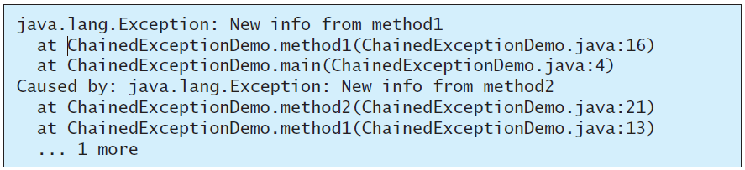
☑ Check Point
1 public class ChainedExceptionDemo {
2 public static void main(String[] args) {
3 try {
4 method1();
5 }
6 catch (Exception ex) {
7 ex.printStackTrace();
8 }
9 }
10
11 public static void method1() throws Exception {
12 try {
13 method2();
14 }
15 catch (Exception ex) {
16 throw new Exception("New info from method1", ex);
17 }
18 }
19
20 public static void method2() throws Exception {
21 throw new Exception("New info from method2");
22 }
23 }
What would be the output if line 16 is replaced by the following line? throw new Exception("New info from method1");
<--- ANSWER --->
The output will be java.lang.Exception: New info from method1 at ChainedExceptionDemo.method1(ChainedExceptionDemo.java:16) at ChainedExceptionDemo.main(ChainedExceptionDemo.java:4)

Slide 66
Defining Custom Exception Classes
Use the exception classes in the API whenever possible.
Define custom exception classes if the predefined classes are not sufficient.
Define custom exception classes by extending Exception or a subclass of Exception.

Slide 67
Custom Exception Class Example
In Listing 13.8, the setRadius method throws an exception if the radius is negative. Suppose you wish to pass the radius to the handler, you have to create a custom exception class.
InvalidRadiusException
CircleWithRadiusException
TestCircleWithRadiusException
Run

Slide 68
☑ Check Point
How do you define a custom exception class?
<--- ANSWER --->
To define a custom class, extend Exception or a subclass of Exception.

Slide 69
☑ Check Point
Suppose the setRadius method throws the InvalidRadiusException defined in Listing 12.10. What is displayed when running the following program? public class Test { public static void main(String[] args) { try { method(); System.out.println("After the method call"); } catch (RuntimeException ex) { System.out.println("RuntimeException in main"); } catch (Exception ex) { System.out.println("Exception in main"); } } static void method() throws Exception { try { Circle c1 = new Circle(1); c1.setRadius(-1); System.out.println(c1.getRadius()); } catch (RuntimeException ex) { System.out.println("RuntimeException in method()"); } catch (Exception ex) { System.out.println("Exception in method()"); throw ex; } } }
<--- ANSWER --->
Exception in method() Exception in main Reason: the setRadius method throws a RadiusException. RadiusException is a subclass of Exception. So it is caught in method()'s handler. The handler rethrows it back to the main method.

Slide 70
Text I/O
Notes:
Data stored in the program are temporary; they are lost when the program terminates.
To permanently store the data created in a program, you need to save them in a file on a disk.
The file can then be transported and read later by other programs.

Slide 71
Objectives
To discover file/directory properties, to delete and rename files/directories, and to create directories using the File class.
To write data to a file using the PrintWriter class.
To use try-with-resources to ensure that the resources are closed automatically.
To read data from a file using the Scanner class.
To understand how data is read using a Scanner.
To develop a program that replaces text in a file.

Slide 72
The File Class
The File class is intended to provide an abstraction that deals with most of the machine-dependent complexities of files and path names in a machine-independent fashion.
The filename is a string.
The File class is a wrapper class for the file name and its directory path.
Notes:
Every file is placed in a directory in the file system.
Absolute file name
Relative file name
Do not use absolute file names in your program.

Slide 73
The File Class
The File class contains the methods – for obtaining file and directory properties – for renaming and deleting files and directories.
However, the File class does not contain the methods for reading and writing file content
Notes:
- Constructing a File instance does not create a file on the machine.

Slide 74
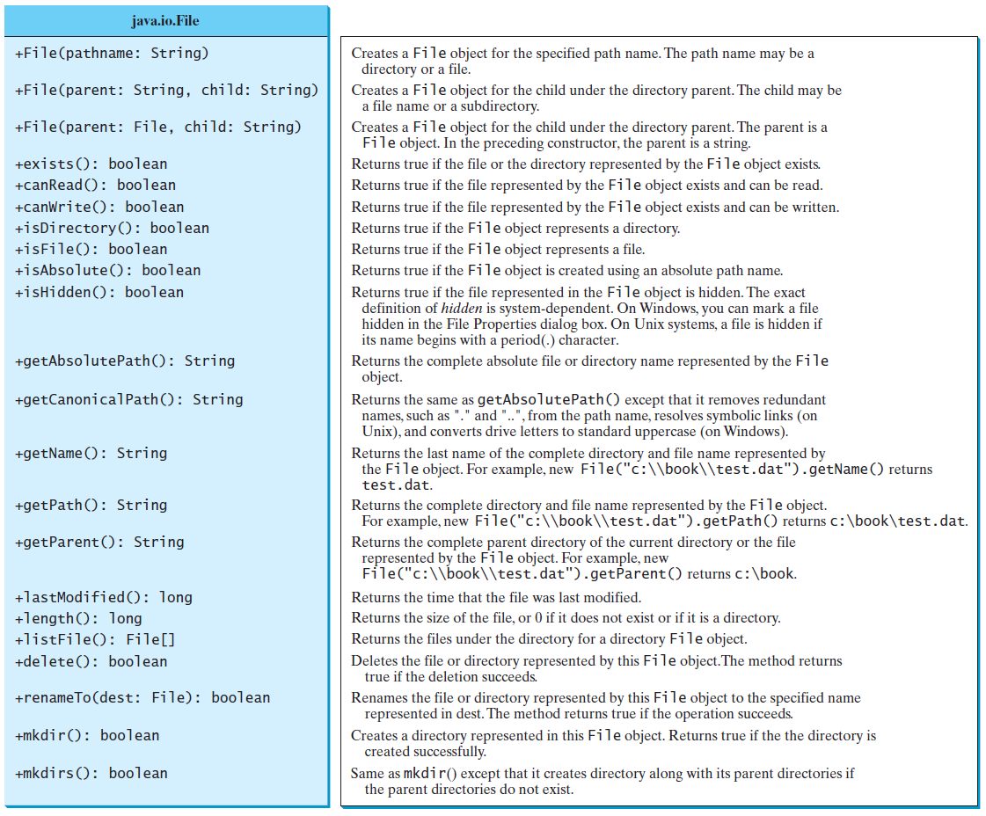
Obtaining file properties and manipulating file

Slide 75
Explore File Properties
java.io.File file = new java.io.File("image/us.gif"); System.out.println("Does it exist? " + file.exists()); System.out.println("The file has " + file.length() + " bytes"); System.out.println("Can it be read? " + file.canRead()); System.out.println("Can it be written? " + file.canWrite()); System.out.println("Is it a directory? " + file.isDirectory()); System.out.println("Is it a file? " + file.isFile()); System.out.println("Is it absolute? " + file.isAbsolute()); System.out.println("Is it hidden? " + file.isHidden()); System.out.println("Absolute path is " + file.getAbsolutePath()); System.out.println("Last modified on " + new java.util.Date(file.lastModified()));
TestFileClass
Run

Slide 76
☑ Check Point
What is wrong about creating a File object using the following statement? new File("c:\book\test.dat");
How do you check whether a file already exists? How do you delete a file? How do you rename a file? Can you find the file size (the number of bytes) using the File class? How do you create a directory?
Can you use the File class for I/O? Does creating a File object create a file on the disk?
<--- ANSWER --->
The \ is a special character. It should be written as \\ in Java using the Escape sequence.
Use exists() in the File class to check whether a file exists. Use delete() in the File class to delete this file. Use renameTo(File) to rename the name for this file. Use length() to return the file size. Use mkdir or mkdirs to create a directory under this File object.
No. The File class can be used to obtain file properties and manipulate files, but cannot perform I/O. No. Creating a File object does not create a file/directory on the disk.

Slide 77
Text I/O
A File object encapsulates the properties of a file or a path, but does not contain the methods for reading/writing data from/to a file.
In order to perform I/O, you need to create objects using appropriate Java I/O classes.
The objects contain the methods for reading/writing data from/to a file.
This section introduces how to read/write strings and numeric values from/to a text file using the Scanner and PrintWriter classes.

Slide 78
Writing Data Using PrintWriter
The java.io.PrintWriter class can be used to create a file and write data to a text file.
First, you have to create a PrintWriter object for a text file as follows:
PrintWriter output = new PrintWriter(filename);
Then, you can invoke the print, println, and printf methods on the PrintWriter object to write data to a file.

Slide 79
Writing Data Using PrintWriter
WriteData
Run
Notes:
- Invoking the constructor of PrintWriter will create a new file if the file does not exist.
If the file already exists, the current content in the file will be discarded without verifying with the user.
Invoking the constructor of PrintWriter may throw an I/O exception.
The close() method must be used to close the file. If this method is not invoked, the data may not be saved properly in the file.

Slide 80
Try-with-resources
Programmers often forget to close the file. JDK 7 provides the followings new try-with-resources syntax that automatically closes the files.
try (declare and create resources) {
Use the resource to process the file;
}
WriteDataWithAutoClose
Run

Slide 81
Reading Data Using Scanner
To read from a file, create a Scanner for a file, as follows: Scanner input = new Scanner(new File(filename))

Slide 82
Reading Data Using Scanner
ReadData
Run

Slide 83
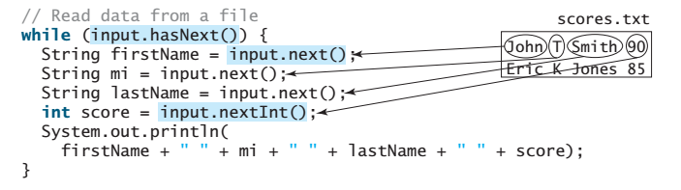
Example

Slide 84
Problem: Replacing Text
Write a class named ReplaceText that replaces a string in a text file with a new string. The filename and strings are passed as command-line arguments as follows:
java ReplaceText sourceFile targetFile oldString newString
For example, invoking
java ReplaceText FormatString.java t.txt StringBuilder StringBuffer
replaces all the occurrences of StringBuilder by StringBuffer in FormatString.java and saves the new file in t.txt.
ReplaceText
Run

Slide 85
☑ Check Point
1 public class WriteData {
2 public static void main(String[] args) throws IOException {
3 java.io.File file = new java.io.File("scores.txt");
4 if (file.exists()) {
5 System.out.println("File already exists");
6 System.exit(1);
7 }
8
9 // Create a file
10 java.io.PrintWriter output = new java.io.PrintWriter(file);
11
12 // Write formatted output to the file
13 output.print("John T Smith ");
14 output.println(90);
15 output.print("Eric K Jones ");
16 output.println(85);
17
18 // Close the file
19 output.close();
20 }
21 }
How do you create a PrintWriter to write data to a file? What is the reason to declare throws Exception in the main method? What would happen if the close() method were not invoked?
<--- ANSWER --->
To create a PrintWriter for a file, use new PrintWriter(filename). This statement may throw an exception. Java forces you to write the code to deal with exceptions. One way to deal with it is to declare throws java.io.IOException in the method declaration. If the close() method is not invoked, the data may not be saved properly.

Slide 86
☑ Check Point
Show the contents of the file temp.txt after the following program is executed. public class Test { public static void main(String[] args) throws java.io.IOException { java.io.PrintWriter output = new java.io.PrintWriter("temp.txt"); output.printf("amount is %f %e\r\n", 32.32, 32.32); output.printf("amount is %5.4f %5.4e\r\n", 32.32, 32.32); output.printf("%6b\r\n", (1 > 2)); output.printf("%6s\r\n", "Java"); output.close(); } }
<--- ANSWER --->
The contents of the file temp.txt is: amount is 32.320000 3.232000e+01 amount is 32.3200 3.2320e+01 false Java

Slide 87
☑ Check Point
Rewrite the following code using a try-with-resources syntax. public class Test { public static void main(String[] args) throws java.io.IOException { java.io.PrintWriter output = new java.io.PrintWriter("temp.txt"); output.printf("amount is %f %e\r\n", 32.32, 32.32); output.printf("amount is %5.4f %5.4e\r\n", 32.32, 32.32); output.printf("%6b\r\n", (1 > 2)); output.printf("%6s\r\n", "Java"); output.close(); } }
<--- ANSWER --->
public class Test { public static void main(String[] args) throws Exception { try (java.io.PrintWriter output = new java.io.PrintWriter("temp.txt");) { output.printf("amount is %f %e\r\n", 32.32, 32.32); output.printf("amount is %5.4f %5.4e\r\n", 32.32, 32.32); output.printf("%6b\r\n", (1 > 2)); output.printf("%6s\r\n", "Java"); } } }

Slide 88
☑ Check Point
1 import java.util.Scanner;
2
3 public class ReadData {
4 public static void main(String[] args) throws Exception {
5 // Create a File instance
6 java.io.File file = new java.io.File("scores.txt");
7
8 // Create a Scanner for the file
9 Scanner input = new Scanner(file);
10
11 // Read data from a file
12 while (input.hasNext()) {
13 String firstName = input.next();
14 String mi = input.next();
15 String lastName = input.next();
16 int score = input.nextInt();
17 System.out.println(
18 firstName + " " + mi + " " + lastName + " " + score);
19 }
20
21 // Close the file
22 input.close();
23 }
24 }
How do you create a Scanner to read data from a file? What is the reason to define throws Exception in the main method? What would happen if the close() method were not invoked?
<--- ANSWER --->
To create a Scanner for a file, use new Scanner(new File(filename)). This statement may throw an exception. Java forces you to write the code to deal with exceptions. One way to deal with it is to declare throws Exception in the method declaration. If the close() method is not invoked, the problem will run fine. But it is a good practice to close the file to release the resource on the file.

Slide 89
☑ Check Point
What will happen if you attempt to create a Scanner for a nonexistent file?
What will happen if you attempt to create a PrintWriter for an existing file?
Is the line separator the same on all platforms? What is the line separator on Windows?
<--- ANSWER --->
If you attempt to create a Scanner for a nonexistent file, an exception will occur.
If you attempt to create a PrintWriter for an existing file, the contents of the existing file will be gone.
No. The line separator on Windows is \r\n.

Slide 90
☑ Check Point
Show the contents of the variables after the following code is executed for the cases given below. Scanner input = new Scanner(System.in); int intValue = input.nextInt(); double doubleValue = input.nextDouble(); String line = input.nextLine();
Suppose you enter 45 57.8 789, then press the Enter key.
Suppose you enter 45, press the Enter key, 57.8, press the Enter key, 789, and press the Enter key.
<--- ANSWER --->
intValue contains 45. doubleValue contains 57.8, and line contains ' ', '7', '8', '9’.
intValue contains 45. doubleValue contains 57.8, and line is empty.

